Slide 1
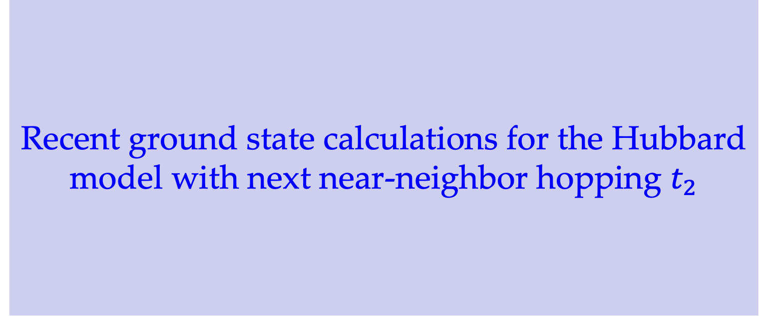
Recent ground state calculations for the Hubbard model with next near-neighbor hopping $t_{2}$
March 26, Group meeting

Slide 2
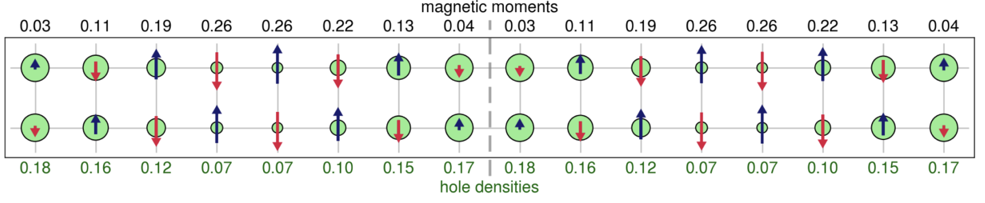
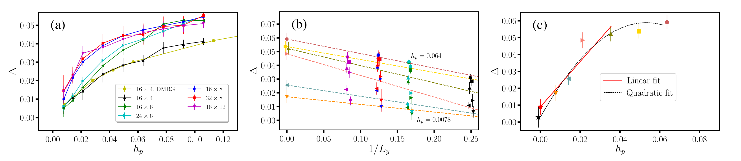
Background: the absent SC in the Hubbard model
Mingpu Qin, el. al, PRX 2020;
B.-X. Zheng, el. al, Science 2017;
J. P. F. LeBlanc, el. al, PRX 2015;
DMRG calculated charge and spin order
CP-AFQMC calculated SC correlation

Slide 3
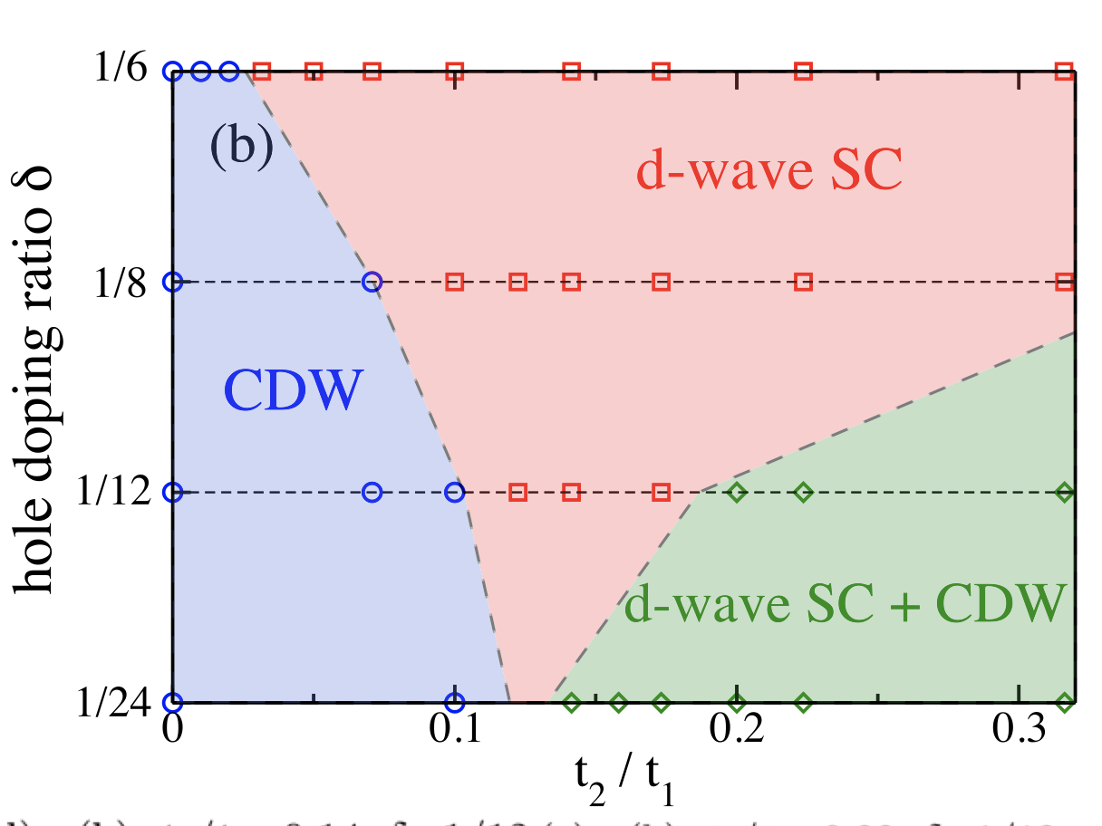
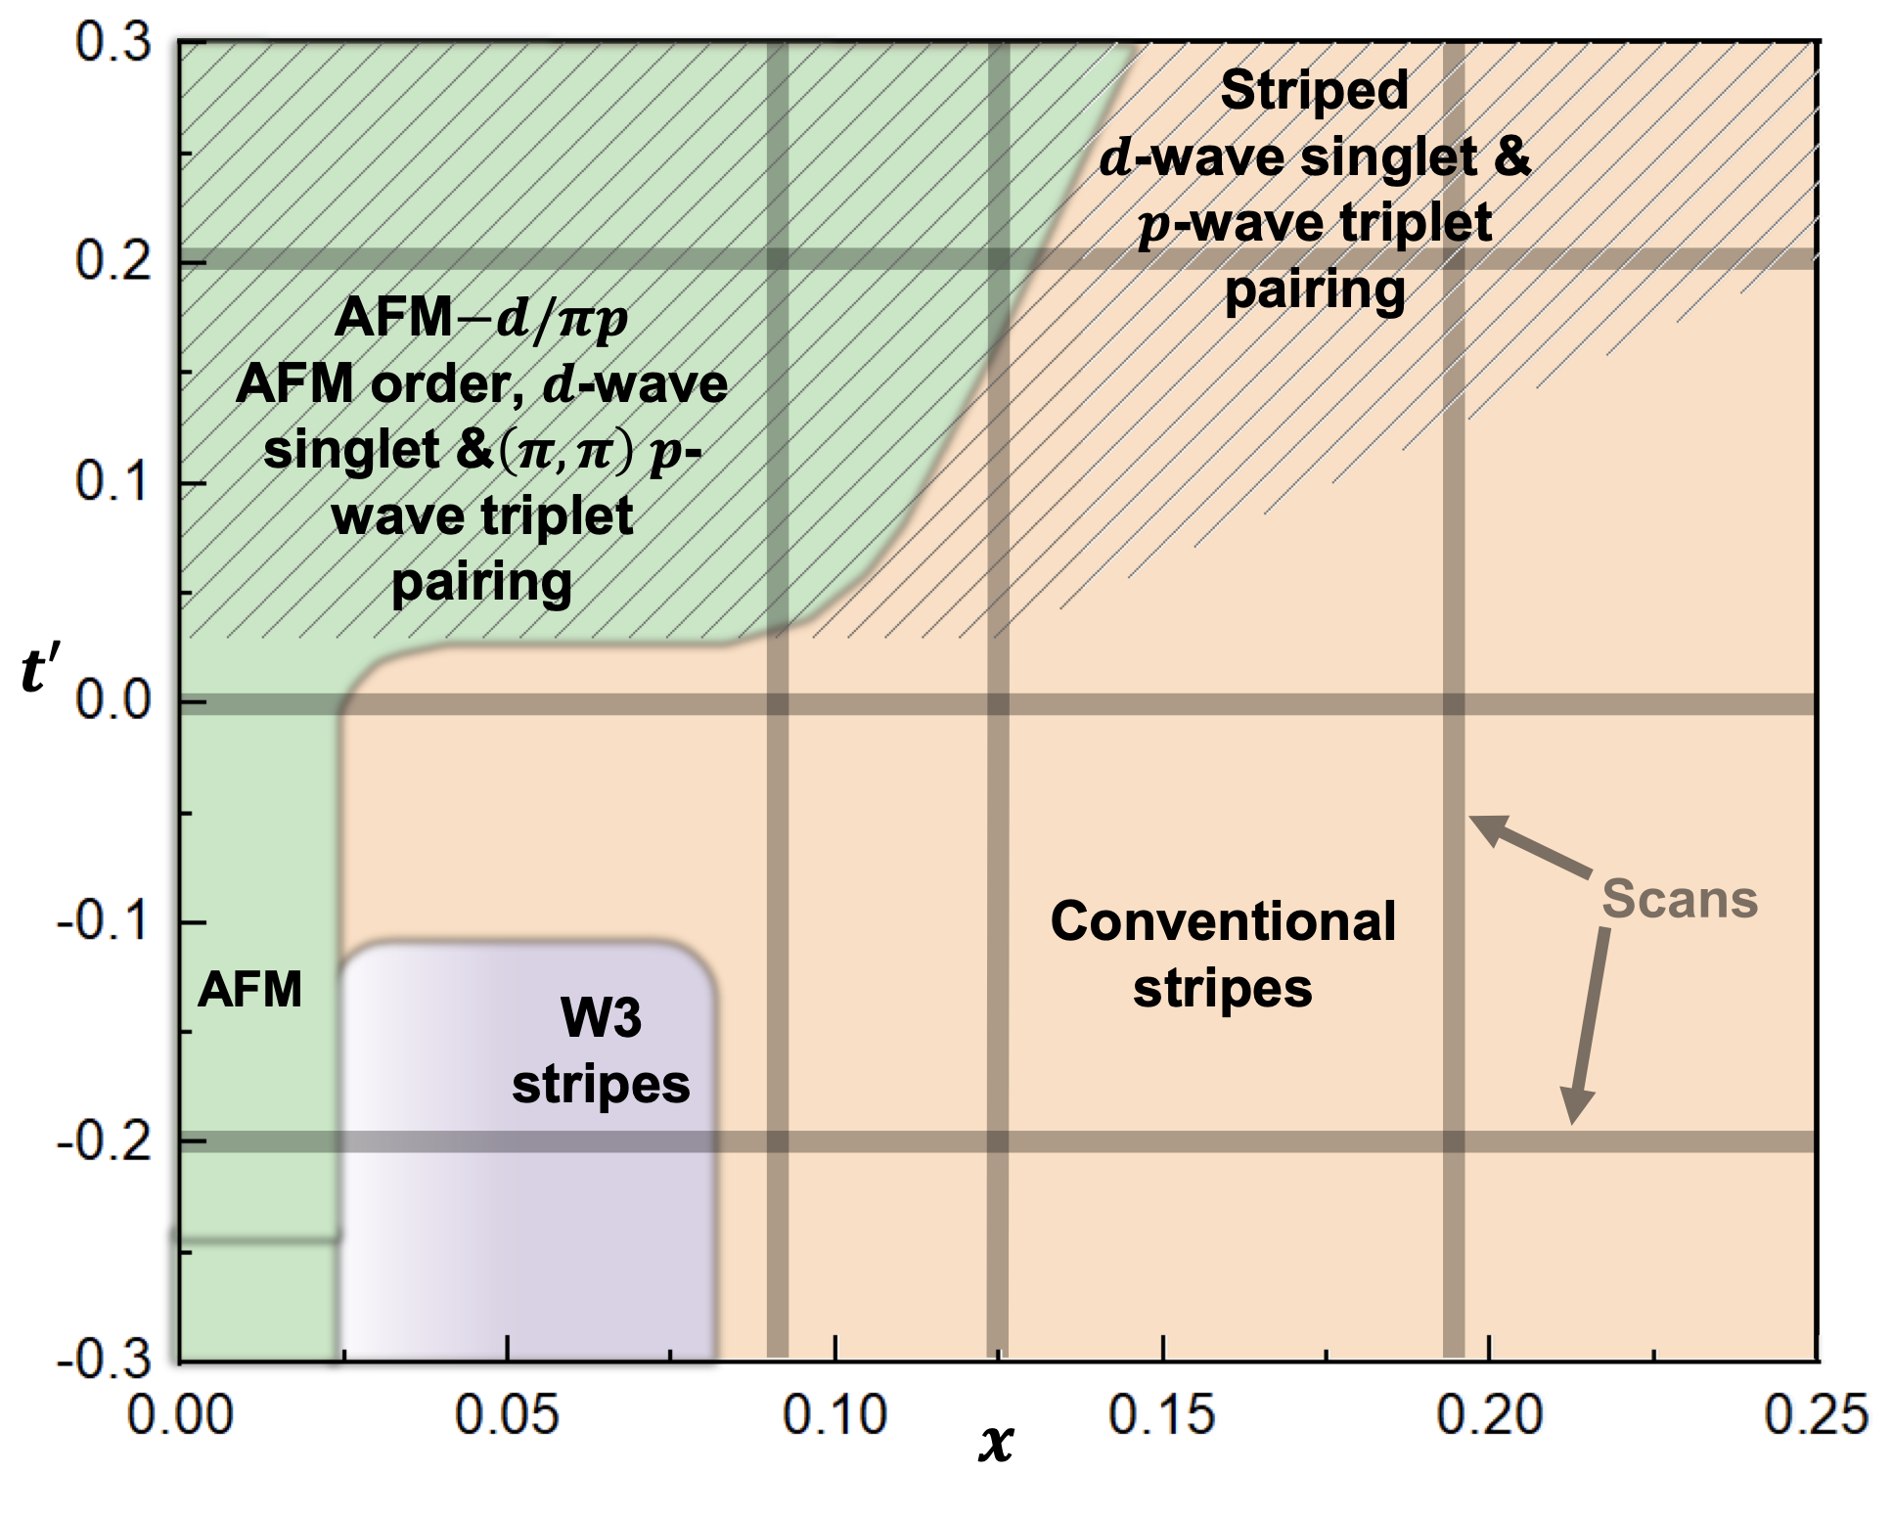
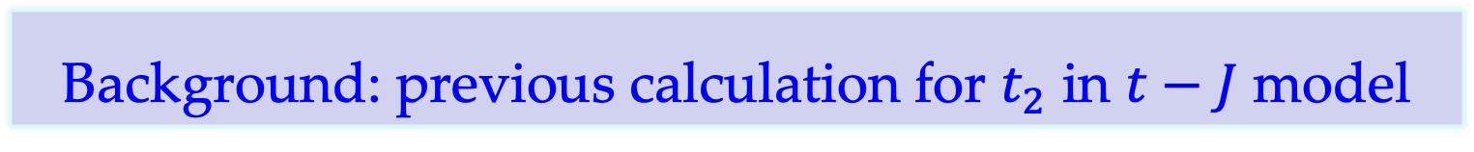
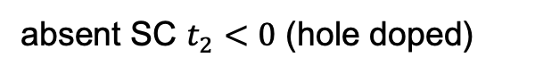
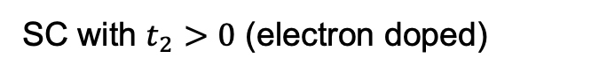
Background: previous calculation for $t_{2}$ in $t−J$ model
SC with $t_{2}>0$ (electron doped)
absent SC $t_{2}<0$ (hole doped)
D. N. Sheng, et. al PRL 2021
S. Jiang, D. J. Scalapino, and S. R. White, PNAS 2021
using sufficient large bond dimension D ~ 60000, on 6-leg ladder
using D ~ 3000, on 8-leg ladder,
without imposing the quantum number and manually break the symmetries.

Slide 4
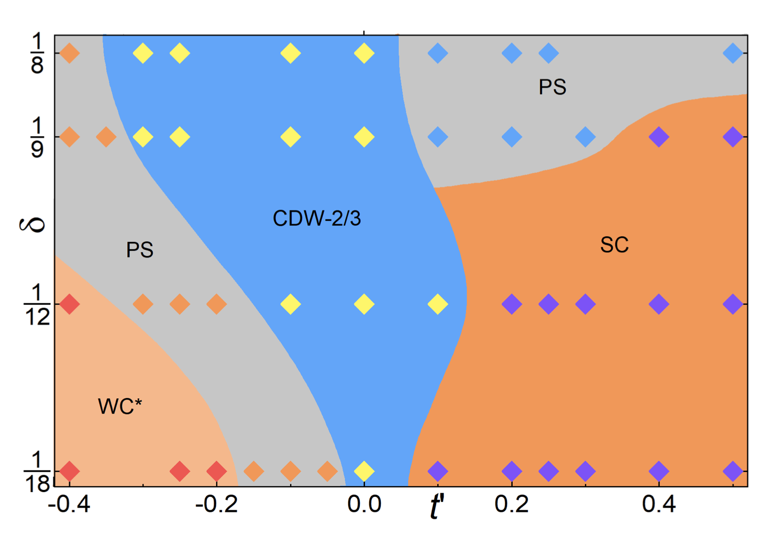
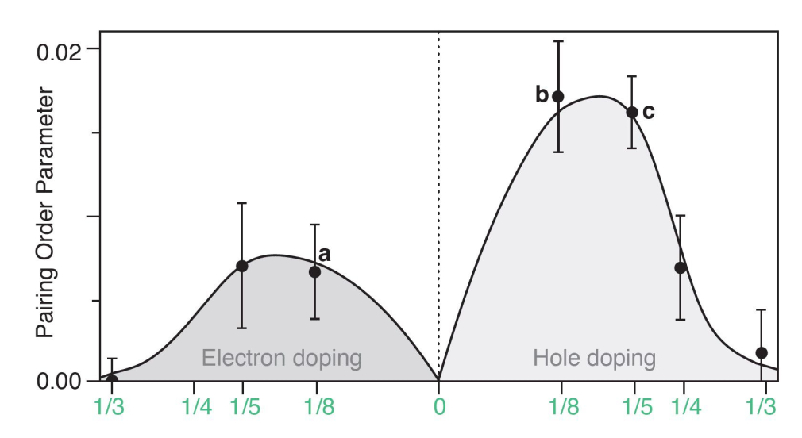
Main results comparison
Coexistence of superconductivity with partially filled stripes in the Hubbard model
Ground state phase diagram and superconductivity of the doped Hubbard model on six-leg square cylinders
Hao Xu, Chia-Min Chung, Mingpu Qin, Ulrich Schollwoeck, Steven R. White, and Shiwei Zhang
Yi-Fan Jiang, Thomas P. Devereaux, and Hong-Chen Jiang
U:
8t
12t
Principlemethod:
Contrained-path AFQMC
DMRG
Width:
upto 16
6

Slide 5
Coexistence of superconductivity with partially filled stripes in the Hubbard model

Slide 6
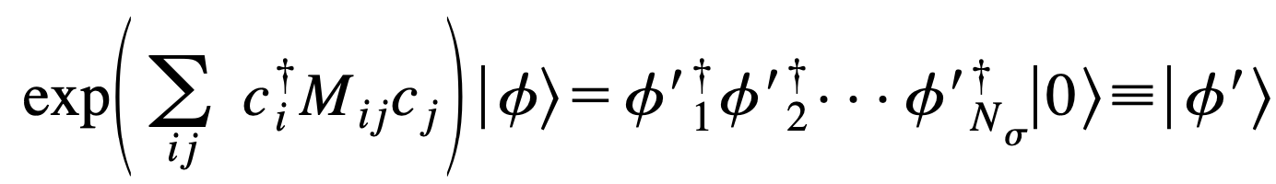
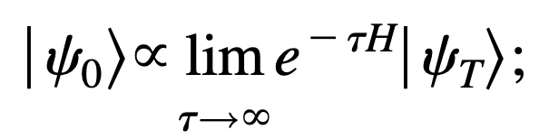
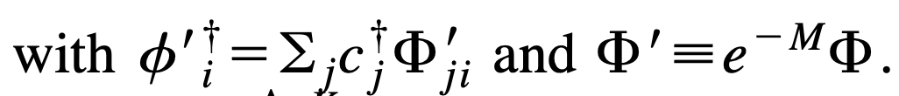
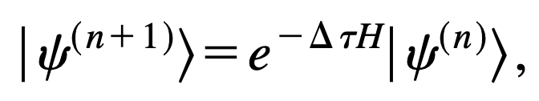
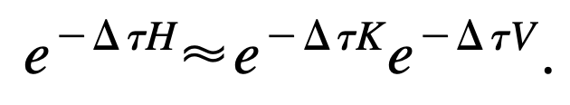
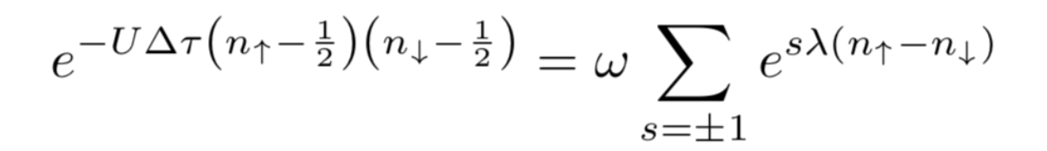
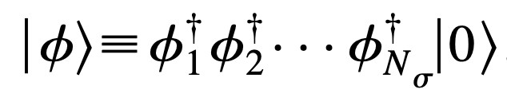
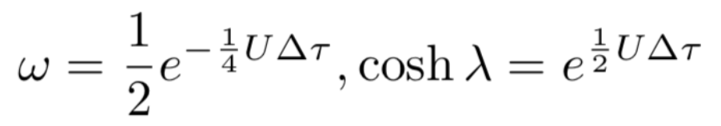
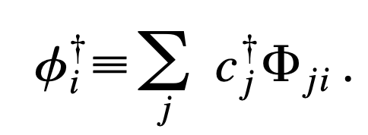
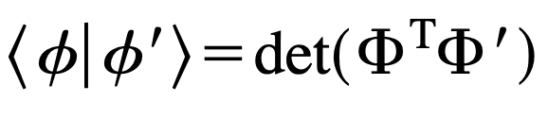
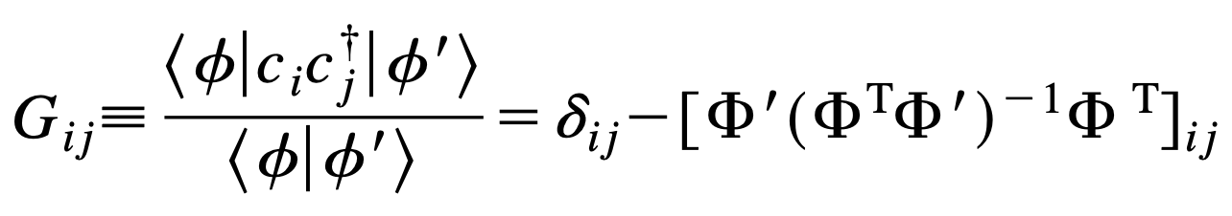
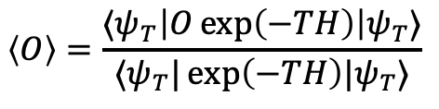
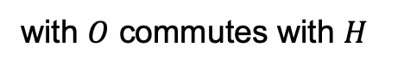
Method: constrained-path auxiliary field QMC
Ground state:
HS transformation:
Slater determinants:
Observation:
$$\left\langle O\right\rangle =\frac{⟨ψ_{T}\left|O\exp\left(−TH\right)\right|ψ_{T}⟩}{⟨ψ_{T}|\exp\left(−TH\right)|ψ_{T}⟩}$$
with $O$ commutes with $H$

Slide 7
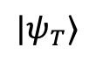
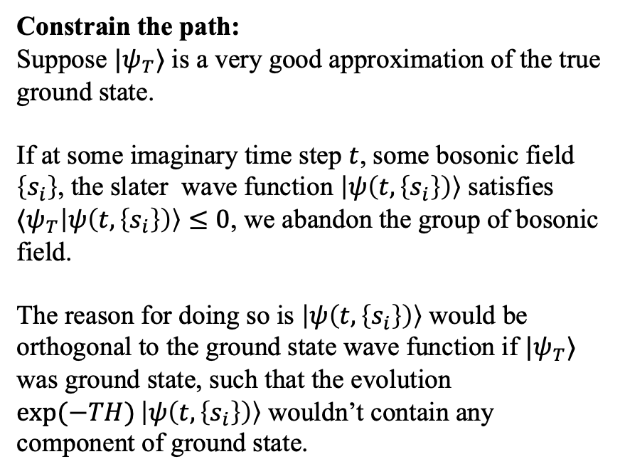
Method: constrained-path auxiliary field QMC
Constrain the path:
Suppose $|ψ_{T}⟩$ is a very good approximation of the true ground state.
If at some imaginary time step $t$, some bosonic field $\left\{s_{i}\right\}$, the slater wave function $\left|ψ\left(t, \left\{s_{i}\right\}\right)\right\rangle$ satisfies
$⟨ψ_{T}\left|ψ\left(t, \left\{s_{i}\right\}\right)\right\rangle ≤0$, we abandon the group of bosonic field.
The reason for doing so is $\left|ψ\left(t, \left\{s_{i}\right\}\right)\right\rangle$ would be orthogonal to the ground state wave function if $|ψ_{T}⟩$ was ground state, such that the evolution $\exp{(−TH)}\left|ψ\left(t, \left\{s_{i}\right\}\right)\right\rangle$ wouldn’t contain any component of ground state.
The paths:
different path means different selection of bosonic field
$$|ψ_{T}⟩$$
The trial wave functions in their work are always the gaussian states (slater determinate).
As calcuating the spin and charge order, the the trial wave functions are found by self-consistent mean field.
As calculating the SC order, they use fermi sea + self-consistent pairing field. ( I will short introduce it later.)

Slide 8
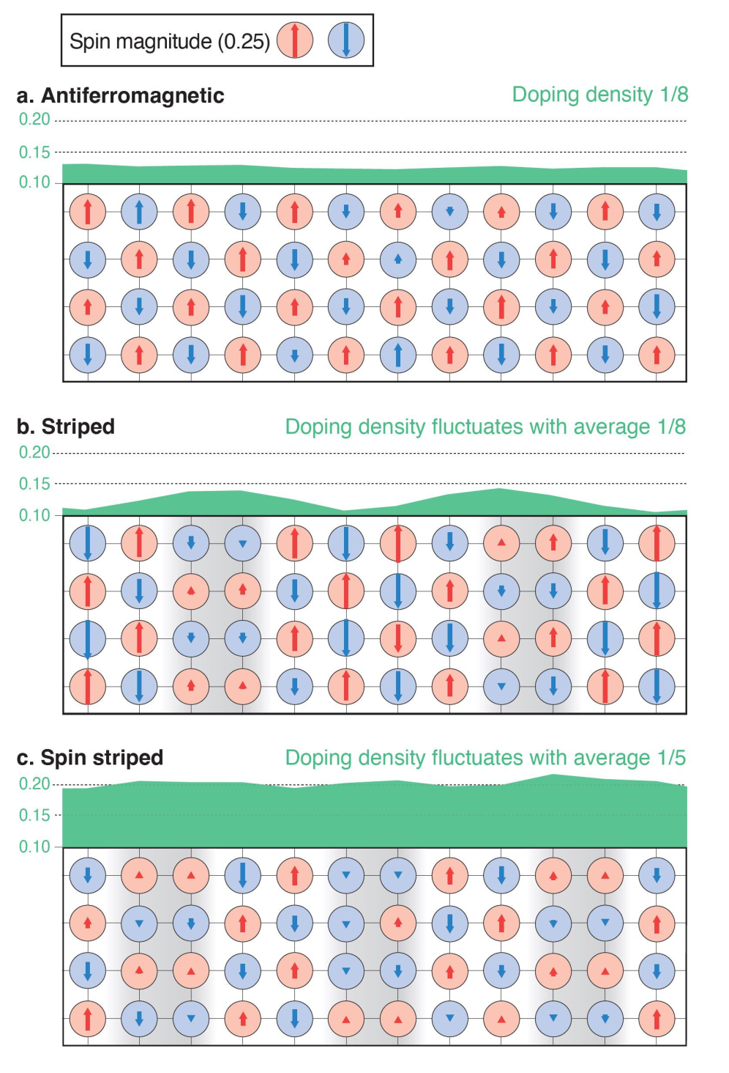
Results
Charge and spin patterns.
These three figures are all obtained on width 8 systems by CP-AFQMC.

Slide 9
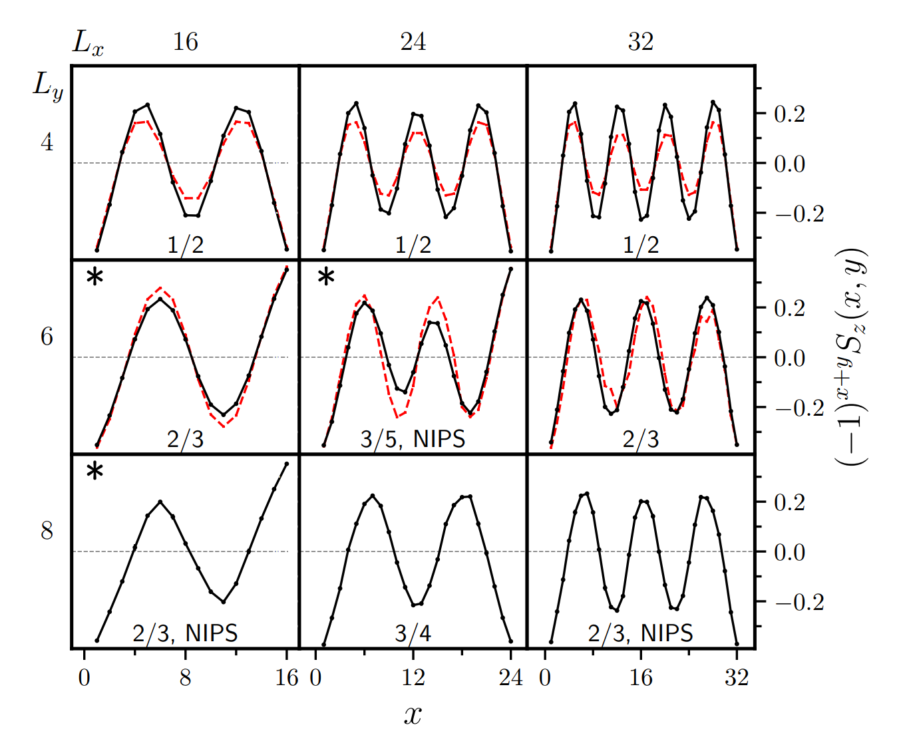
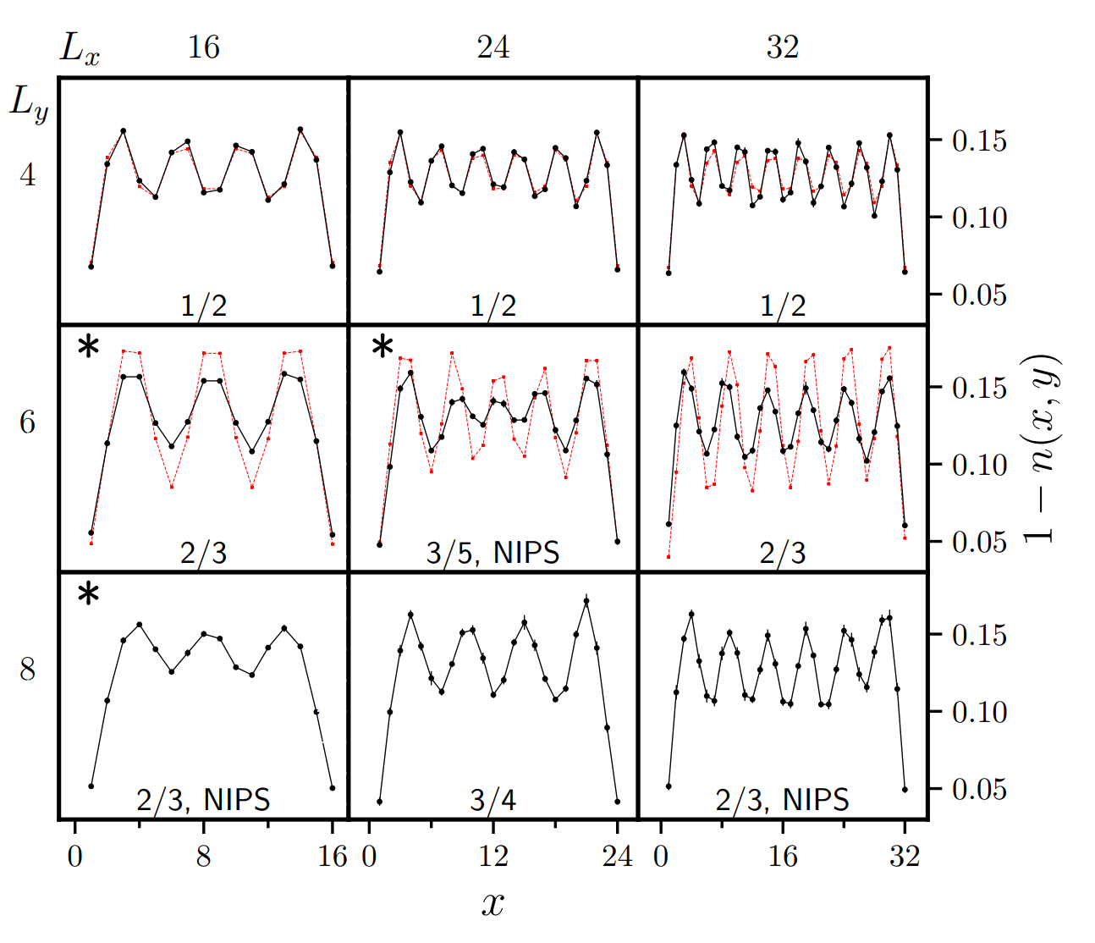
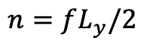
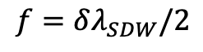
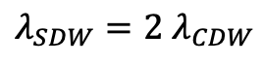
Underdoped region: 1/8 hole doping
spin pattern
Red: DMRG
Black: CP-AFQMC
Boundary condition: PBC cylinder
hole density
The nodes of spin modulation $⟷$ Hole density max
$$λ_{SDW}=2 λ_{CDW}$$
﻿the filling fraction of the stripe:
integer, ﻿integer-pair stripe (IPS)
$$f=δλ_{SDW}/2$$
﻿the number of electron pairs per stripe:
$$n=fL_{y}/2$$
non-integer, non-IPS (NIPS)
Notes:
带星是说，两头的反铁磁pining field，加的方向不一样。一样和不一样都挑能量低的画的。

Slide 10
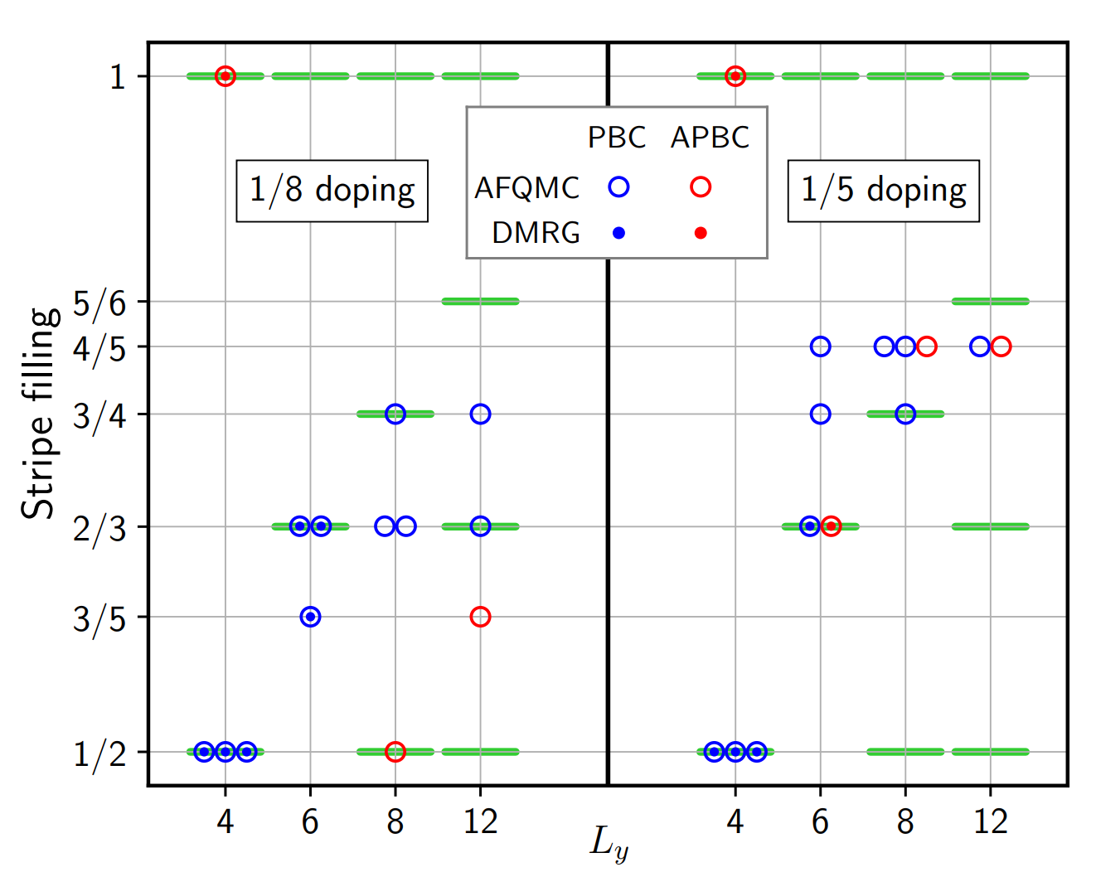
Underdoped region: 1/8 hole doping
spin pattern
partially filled stripe patterns
Red: DMRG
Black: CP-AFQMC
Boundary condition: PBC cylinder
The nodes of spin modulation $⟷$ Hole density max
$$λ_{SDW}=2 λ_{CDW}$$
﻿the filling fraction of the stripe:
integer, ﻿integer-pair stripe (IPS)
$$f=δλ_{SDW}/2$$
﻿the number of electron pairs per stripe:
$$n=fL_{y}/2$$
non-integer, non-IPS (NIPS)
Notes:
带星是说，两头的反铁磁pining field，加的方向不一样。一样和不一样都挑能量低的画的。

Slide 11
Overdoped region: 1/5 hole doping
partially filled stripe patterns
NIPS
﻿Both the spin and charge modulations are weaker at 1/5 doping than at 1/8.
IPS
Notes:
带星是说，两头的反铁磁pining field，加的方向不一样。一样和不一样都挑能量低的画的。

Slide 12
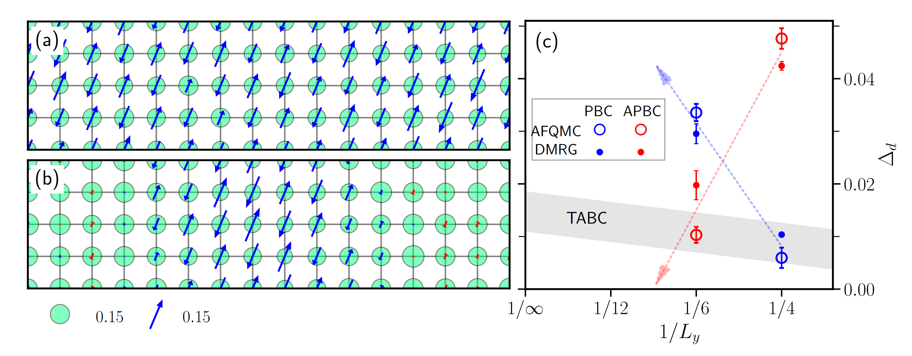
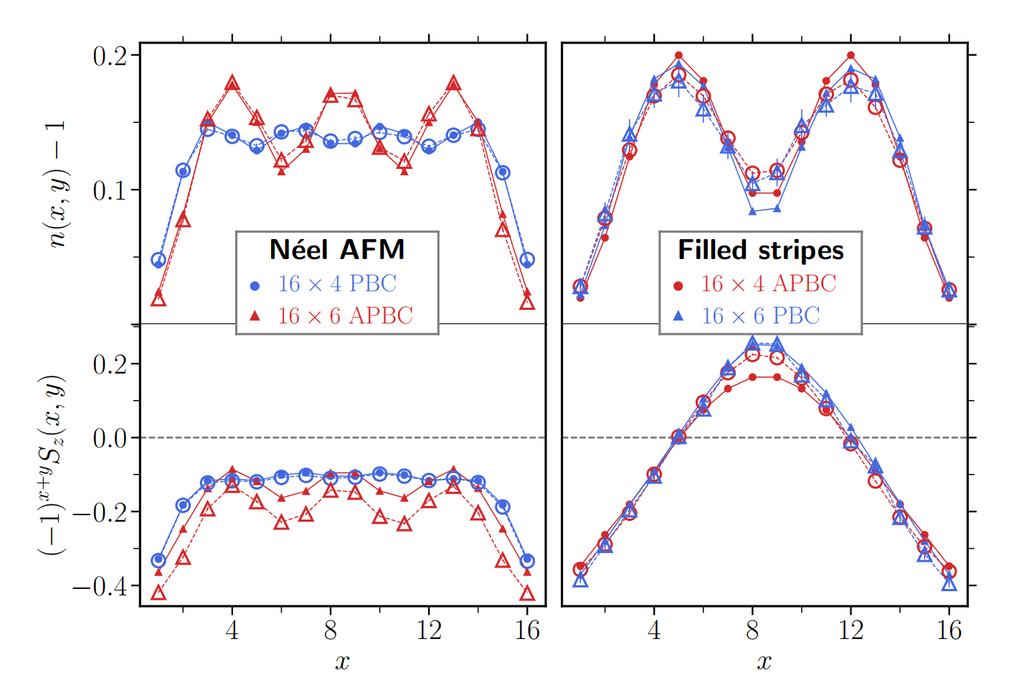
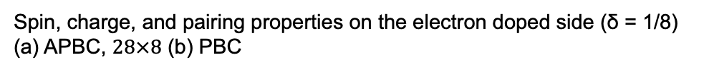
Electron doped region
﻿Experimentally, the electron-doped side is simpler, without the competing stripe state or pseudogap phase in cuprates.
﻿Spin, charge, and pairing properties on the electron doped side (δ = 1/8)
(a) APBC, $28×8$ (b) PBC

Slide 13
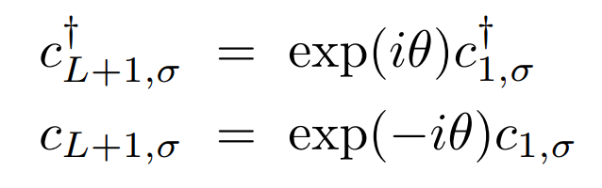
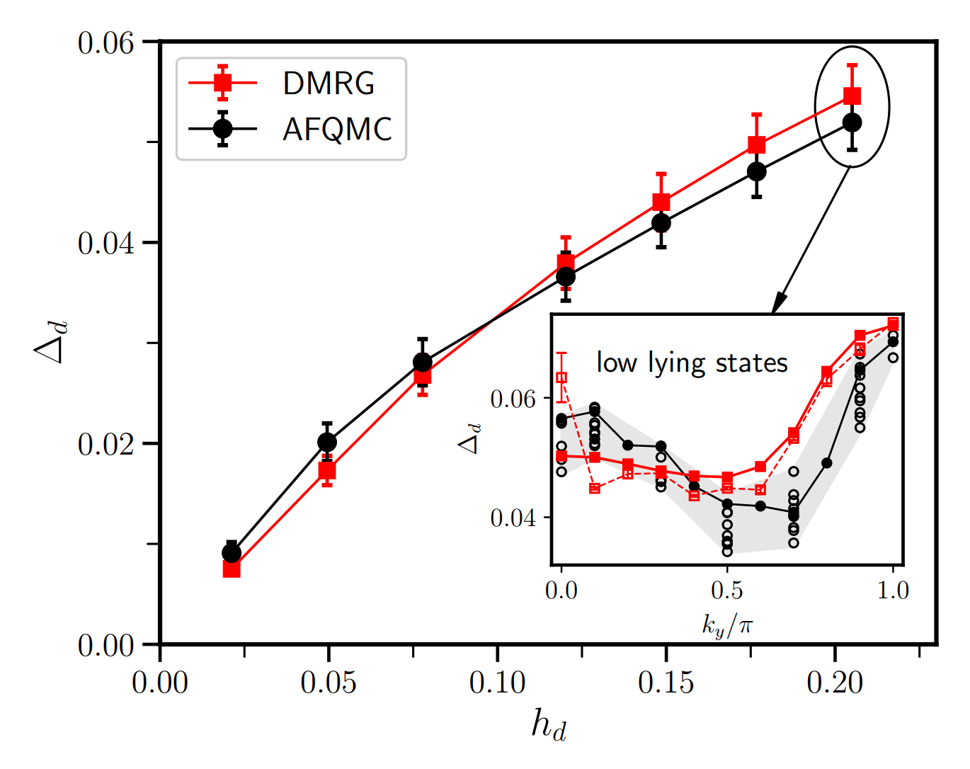
﻿twist averaged boundary conditions
﻿20×4 cylindrical cell at 1/5 hole doping

Slide 14
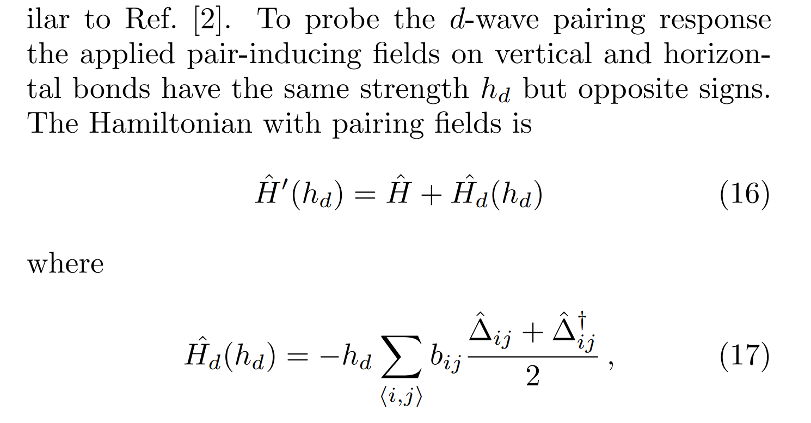
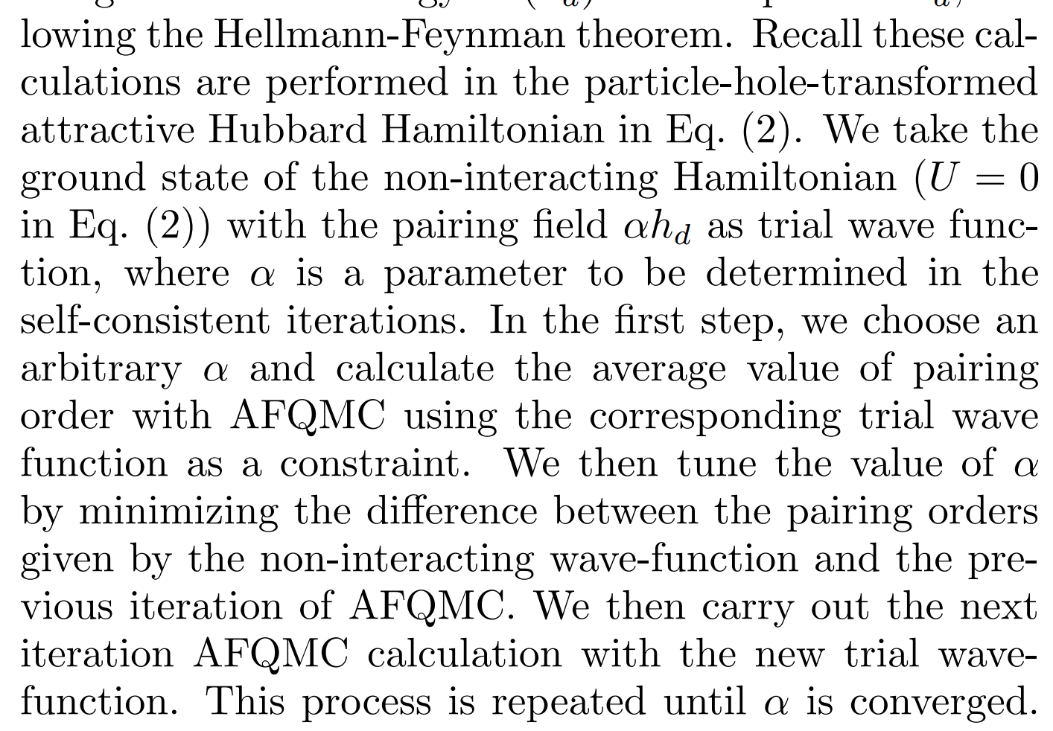
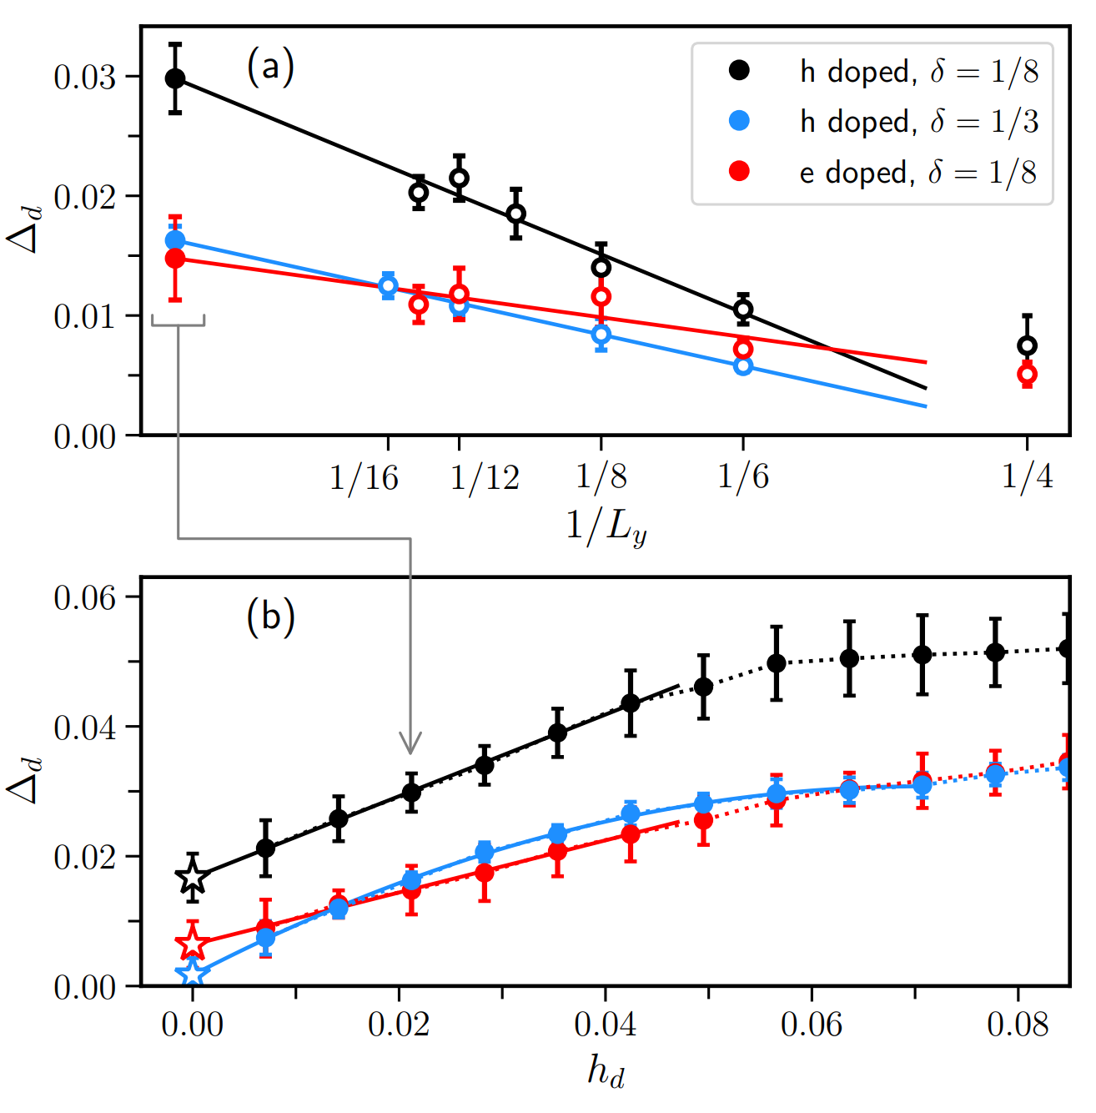
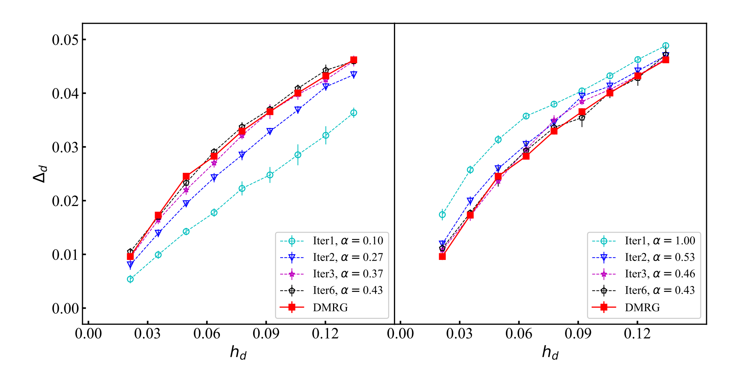
﻿Pairing order parameter
Self-consistent method:
PBC, twist angles on both x and y direction
﻿1/4 hole-doped Hubbard model on a 16×4 cylinder

Slide 15
Ground state phase diagram and superconductivity of the doped Hubbard model on six-leg square cylinders
t-t’-J hole doped phase diagram
Ground state phase diagram of the Hubbard model at U=12
SC: d-wave SC phase
WC*: holon Wigner crystal
PS: phase seperation
CDW-2/3: 2/3 filled stripe

Slide 16
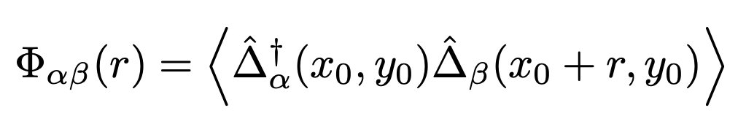
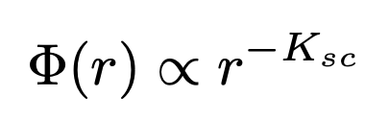
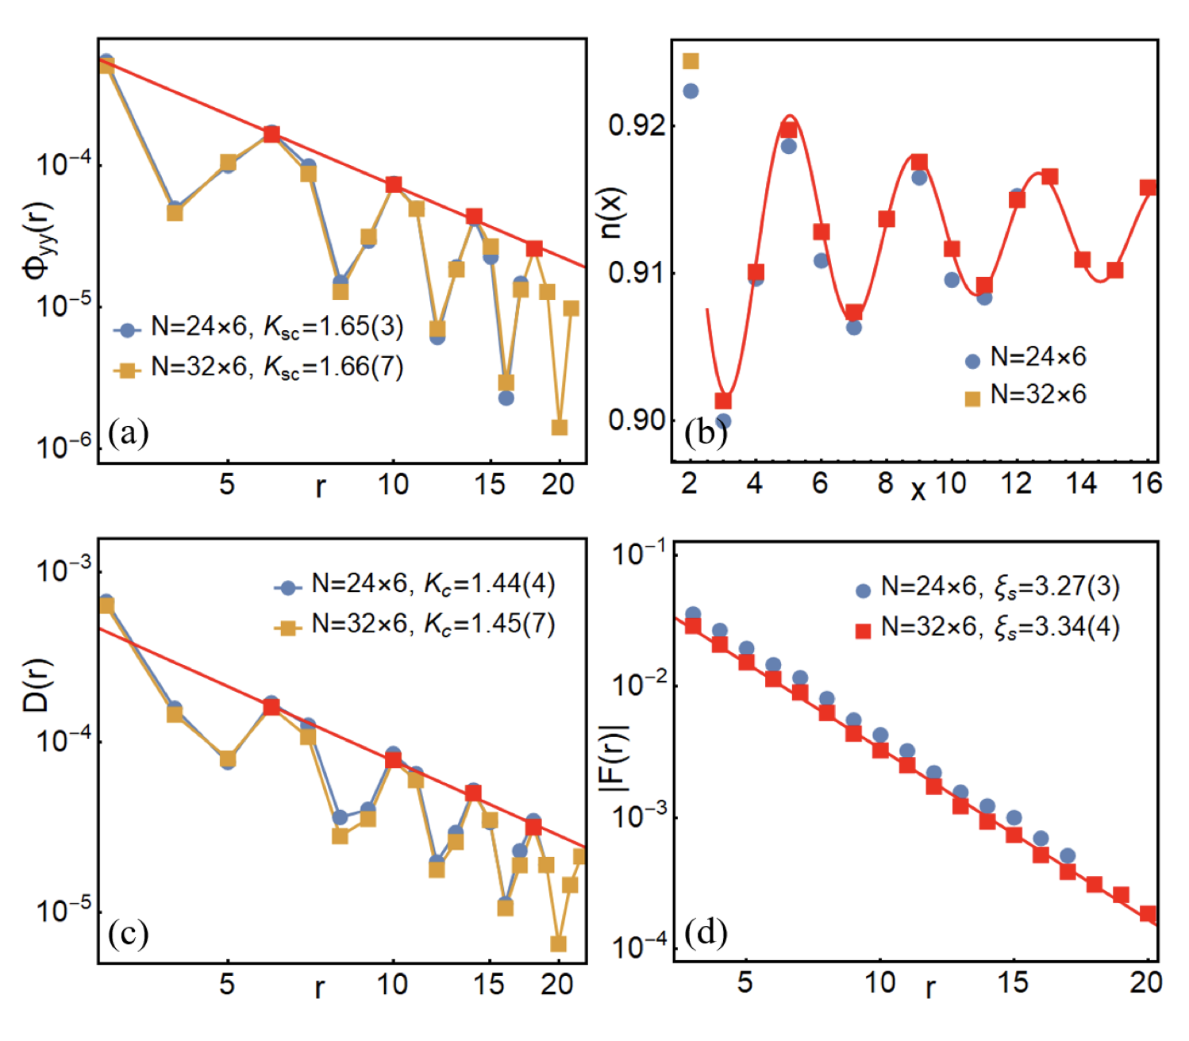
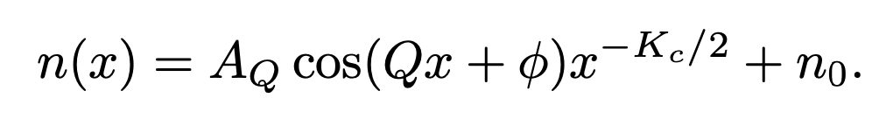
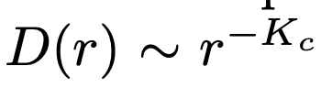
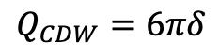

D-wave SC phase
SC correlations:
$$λ_{CDW}=4=\frac{1}{3δ}$$
$$Q_{CDW}=6πδ$$
two holes per super unit cell
The same with 6-leg t-J model

Slide 17
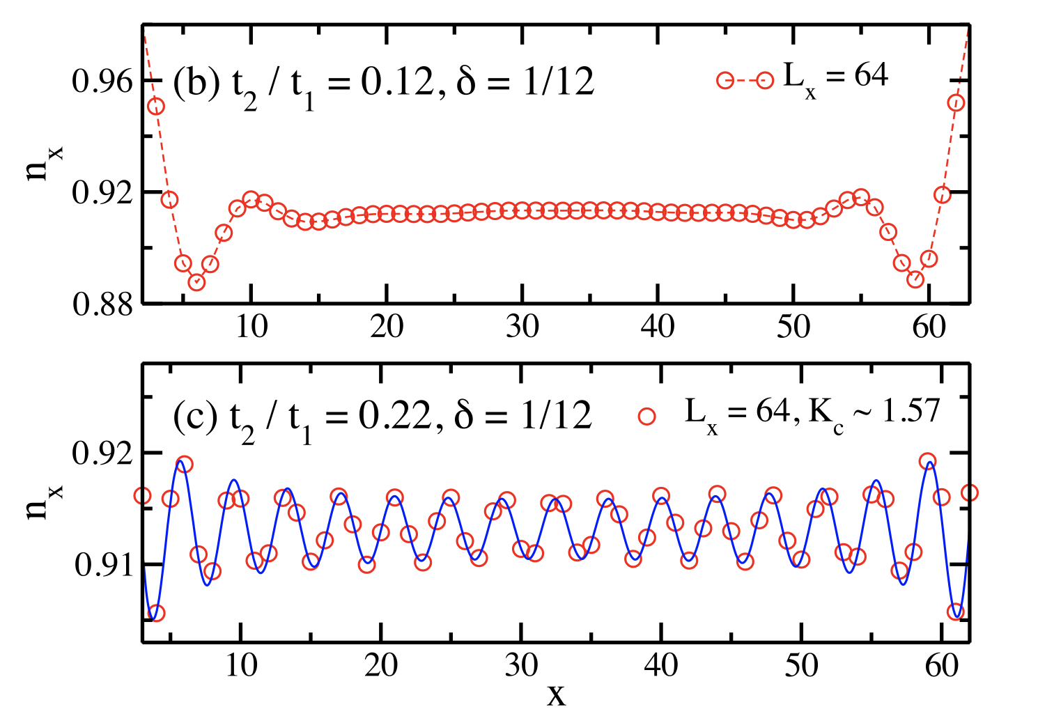
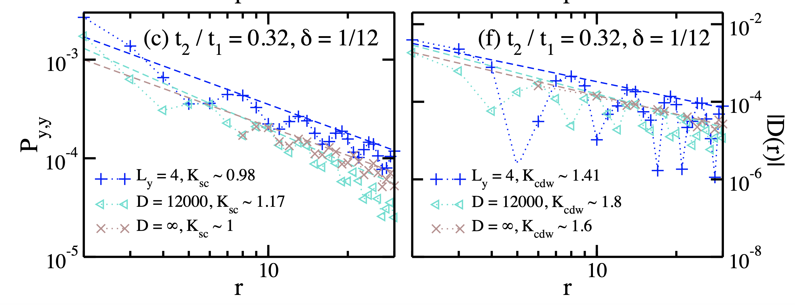
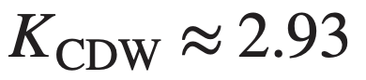




Corresponding d-wave SC phase in the t-t2-J-J2 model
D. N. Sheng, et. al PRL 2021

Slide 18



CDW-2/3 phase
$$λ_{CDW}=8=\frac{2}{3δ}$$
$$Q_{CDW}=3πδ$$

Slide 19


$$U=8$$
$$δ=\frac{1}{8}$$
$$L_{y}=6$$
$$L_{x}=48$$
$$D=50000$$
$λ_{CDW}:\frac{3}{5}\sim \frac{2}{3}$ stripe

Slide 20




Holon Wigner Crystal
Distinct with the “CDW-2/3” phase, the CDW order in the WC* phase breaks translational symmetries along both the x and y directions
The number of these emergent unit cells is equal to the number of doped holes.
$$λ_{CDW}=8=\frac{2}{3δ}$$
charge density
$$Q_{CDW}=3πδ$$
This CDW state is consistent with a Wigner crystal of holons, where the holon carries the charge of an electron but without its spin, rather than doped holes.

Slide 21
Thanks for your attention!

